Slide 1
Press Button, Get Development Environment
Dev Containers in Action

Slide 2
Yo.

Slide 3
What problem are we solving?

Slide 4
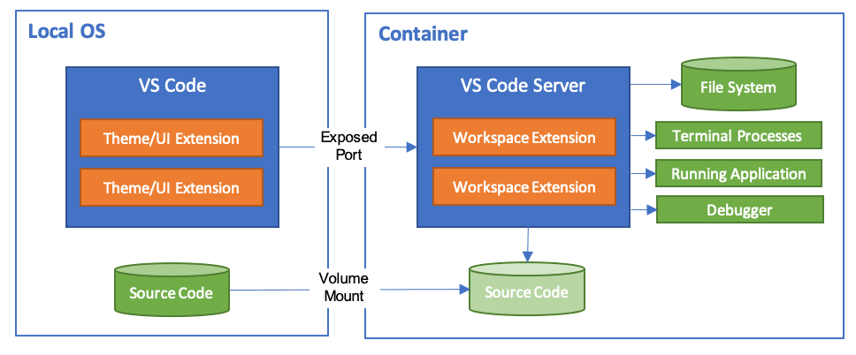
The solution: DevContainers
Image from: https://code.visualstudio.com/docs/remote/containers

Slide 5
What can I do?
Play with a new language / framework without installing it
Create a consistent, standard environment for collaboration
Enterprise
Open-Source projects
Ease the process of onboarding new engineers

Slide 6
Let’s see it in action!

